Slide 1
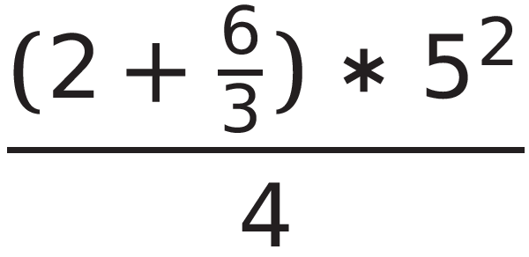
Warm Up:

Slide 2
Number Sets
Natural Numbers: 1, 2, 3, …
Whole Numbers: 0, 1, 2, 3, …
Integers: …-3, -2, -1, 0, 1, 2, 3, …
Rational Numbers: p/q where p and q are integers and q≠0 (can be written as a fraction
Irrational Numbers: non-terminating and non-repeating
Real Numbers: all rational and irrational

Slide 3
Rational Numbers
5
4/5
-3.45
2.333…
Square root of 49

Slide 4
Irrational Numbers
3.46446444644446…
Square root of 11
pi

Slide 5
Some number sets overlap…
Real Numbers
Rational
Irrational
Integer
Whole
Natural

Slide 6
Classify the following numbers
-5/4
2.12112211112222…
83
-7

Slide 7
Classifying number activity

Slide 8
1-2 worksheet

Slide 9
Check point 1

