Slide 1
Get your binder out and be ready for the warm-up!

Slide 2

Solve the following equations. Be sure to check your answers!
$\left|x+\left.6\right|\right.$ = 3x – 2
$\left|2w+\right.\left.3\right|$ + 6 = 2

Slide 3
Quiz Review

Slide 4
Solving Inequalities
1-5

Slide 5
Quick Review
< Less than
≤ Less than or equal to
= Equal to
> Greater than
≥ Greater than or equal to

Slide 6
Some important properties and rules
Trichotomy Property- For any two numbers a & b, EXACTLY one of the following is true
a<b a=b a>b
Adding or subtracting the same numbers from each side does not change the truth of the inequality

Slide 7
Example 1: Solve 7x-5>6x+4
7x - 5> 6x + 4
-6x -6x
x - 5> 4
+5 +5
x > 9
x is any real number greater than 9
Set-builder notation: {x|x > 9}

Slide 8
One more rule!
If you multiply or divide by a positive number on both sides, the truth of the inequality is not changed.
If you multiply or divide by a negative number on both sides, the order of the inequality must be reversed.
In other words, you have to change the inequality sign to the opposite!

Slide 9
Example 2: Solve -0.25y ≥ 2. Graph the solution set on a number line
-0.25y ≥ 2
/-0.25 /-0.25
y ≤ -8
Don’t forget to switch the inequality!!
All real numbers less than or equal to -8
{y|y≤-8}

Slide 10
Another way to write your answer
Interval notation: +∞ and -∞ are used for unbounded sets
These are sets that have no end point
Example: If x < 2 then its interval notation would be (-∞, 2)
How would we write the last example in interval notation?
(-∞, -8]

Slide 11
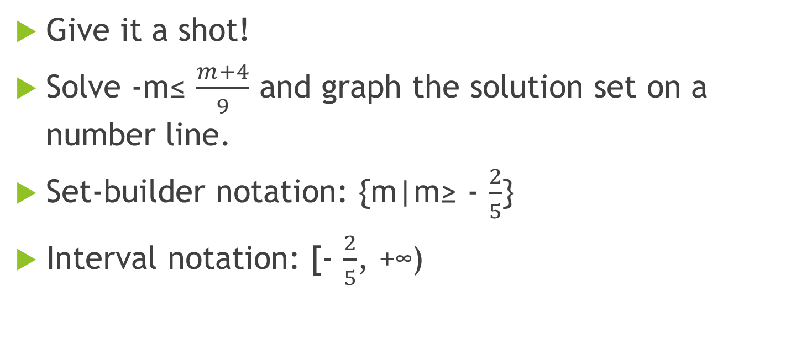
Multi-step inequalities
Give it a shot!
Solve -m≤ $\frac{m+4}{9}$ and graph the solution set on a number line.
Set-builder notation: {m|m≥ - $\frac{2}{5}$}
Interval notation: [- $\frac{2}{5}$, +∞)

Slide 12
How are solving equations and solving inequalities alike? Different?

Slide 13
Writing real-world inequalities
Craig is delivering boxes of paper to each floor of an office building. Each box weighs 64 pounds, and Craig weighs 160 pounds. If the maximum capacity of the elevator is 2000 pounds, how many boxes can Craig safely take on each elevator trip?
160 + 64b ≤ 2000
Notes:
Talk about where the numbers come from and the set up before you show the inequality. Then have students solve for the number of boxes.

Slide 14
Closure
Solve 23 – 4m < 11. Graph the solution set on a number line.

